Slide 1
Transition & Transformation Planning for CPMC 2020
December 7, 2017
Notes:
Hamila: Slides 1-21
Jim: Slides 22 – 35

Slide 2
A Poem
Today was the absolute worst day ever And don't try to convince me that There's something good in every day Because, when you take a closer look, This world is a pretty evil place. Even if Some goodness does shine through once in a while Satisfaction and happiness don't last. And it's not true that It's all in the mind and heart Because True happiness can be attained Only if one's surroundings are good It's not true that good exists I'm sure you can agree that The reality Creates My attitude It's all beyond my control And you'll never in a million years hear me say Today was a very good day
Notes:
Hamila
Chanie Gorkin, a 17-year-old about to enter the 12th grade at the Lubavitch high school Beth Rivkah, originally wrote the poem entitled “Worst Day Ever?” for an assignment at school.
“I don’t think there is such a thing as the worst day ever,” Gorkin told 1010 WINS in an exclusive interview Monday. “I wanted to show how your day is really based on how you look at things.”
The poem is inspired by Talmudic teachings.
“It comes from Hasidic philosophy, which I learn daily and try to take to heart, so I try my best to live what I wrote,” Gorkin said.
The complex poem contains a surprise. From top to bottom it reads negatively, but when read in reverse the message drastically changes.
http://newyork.cbslocal.com/2015/07/27/worst-day-ever-poem-goes-viral/

Slide 3
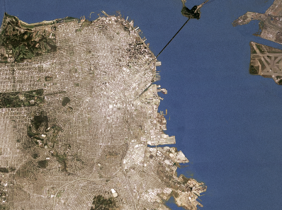

The Case for Change: CPMC Hospitals Transition
The Challenge
Comply with seismic safety requirements
The Opportunity
is for CPMC to transform its footprint and redefine care delivery in San Francisco by:
Developing the ribbon of care
Focus on safety and quality
Improve access and better serve our community
Be more efficient (and affordable)
Redefine our culture as “CPMC”
From |  | To
4 traditional hospitals |  | 3 hospitals with 2 built to modern standards
Shared patient rooms with limited views |  | Upgraded private rooms with exterior views and natural light
Facilities with disparate cultures and identities |  | A unified system with a shared culture and one type of care-great care
Dated operational systems and processes |  | New and advanced technology-enabled systems
Existing communities served |  | Improved access in communities served
Pacific Campus
“We hold the key to transforming healthcare in SF by leading, embracing, and engaging in the change that is about to happen. Please join me on this exciting journey and be part of something great in SF.”
Hamila Kownacki
COO, CPMC
Van Ness Campus
Davies Campus
RIBBON OF CARE
Mission Bernal Campus
Notes:
Hamila
Transition to and introduce Change Team (Eli Harning and Pedro Laraia)

Slide 4
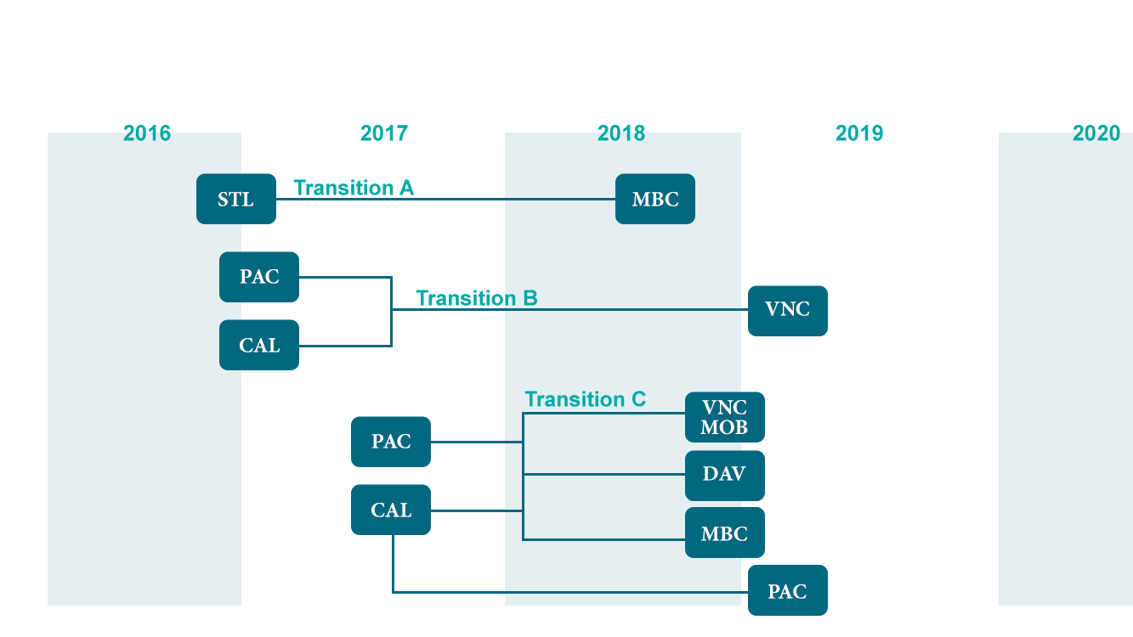
Transition Schedule
2017
2018
2019
2020
Transition A
STL
MBC
Transition B
PAC
VNC
CAL
Transition C
VNC MOB
PAC
DAV
CAL
MBC
PAC
Notes:
MBC to Fall 2018
VNC = March April
VNC MOB, just behind MBC
DAV, MBC, PAC to 2019 Q4

Slide 5
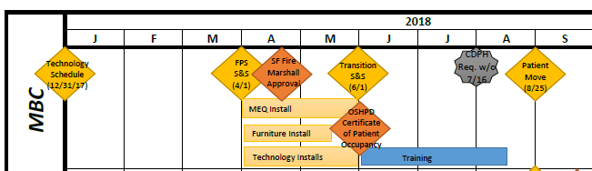
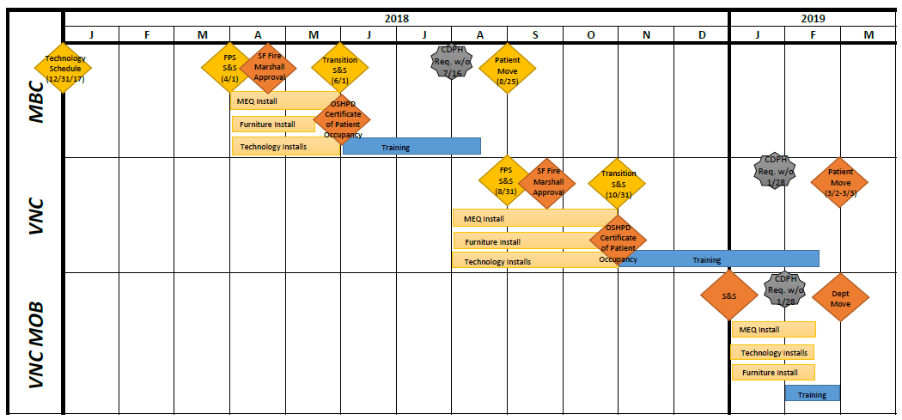
Timeline
Notes:
Need updated version
DAVIES SCHEDULE:
New Conference Center-S. Tower Fall 2017
ADA-upgraded patient rooms December 31, 2017
Pathology Dept relocation June 2018
ED expansion December 2018
Seismic upgrade of N. Tower December 2018

Slide 6

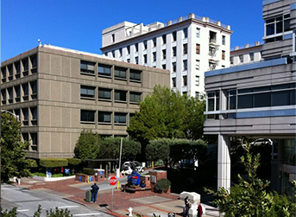
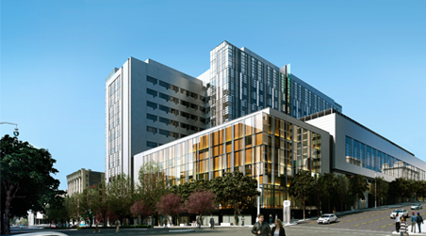

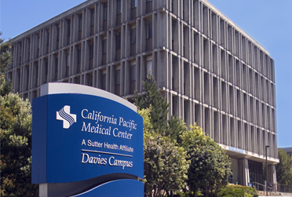
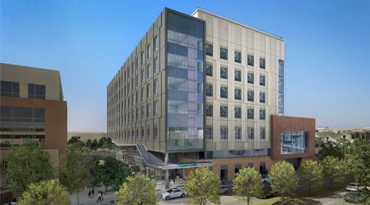
PACIFIC HEIGHTS Outpatient Only
CPMC2020: The Big Picture
Van Ness 274 Acute Beds
519 TOTAL
Licensed Acute BEDS
DAVIES 125 Acute & Rehab Beds
Mission bernal 120 Acute Beds

Slide 7
Pacific Heights Outpatient Only
Medical
Services
Cancer Services
• Radiation, Navigation, Infusion
Cardiology - OP Diagnostics
Dialysis OP (Davita)
Hematology
Mammography
• Diagnostic, Screening, Ultrasound
Cardiology
Critical Care
Dermatology
Endocrine
Gastrointestinal
(including motility, IES)
General Medicine
Gynecology
Hematology
Infectious Disease
Neurology
Nephrology
Obstetrics
Oncology
Pediatrics
Pulmonary
Rheumatology
Van Ness
274 Acute Beds
Cardiology
Critical Care
Dermatology
Dialysis OP (Davita)
Endocrine
Gastrointestinal
General
Medicine
Geriatrics
Infectious Disease
Nephrology
Neurology
Pulmonary
Psychiatry
Rehab
Rheumatology
Cardiology
Critical Care
Dermatology
Endocrine
Gastrointestinal
General Medicine
Geriatrics (Acute Care for Elderly)
Infectious Disease
Nephrology
Obstetrics
Pulmonary
Rheumatology
Davies 125 Acute & Rehab Beds
Mission bernal 120 Acute Beds
Notes:
Slides that have too much content distract the audience from the presenter.

Slide 8
Pacific Heights Outpatient Only
Surgical
NOTES:
Van Ness and Davies can accommodate limited outpatient services as available
Subject to change
Services
ENT
Hand
General Surgery
Gynecology
Ophthalmology
Oral /
Maxillofacial /
Dental
Plastics
(Cosmetic)
Podiatry
Urology
Cardiovascular / Cardiothoracic
ENT
General Surgery
Gynecology
Microsurgery
Neurosurgery
Neonatologic
Pediatric
Spine
Transplant / Foregut
Urology
Vascular
[one robot – SI]
Van Ness
274 Acute Beds
[two robots – XI]
ENT
Gender Surgery
General Surgery
Neurosurgery
Orthopedics
Spine
Plastics (Microsurgery)
ENT
Gynecology
General Surgery
Ophthalmology
Orthopedics
Plastics
Podiatry
Urology
Vascular Surgery
Davies 125 Acute & Rehab Beds
Mission bernal 120 Acute Beds

Slide 9
Pacific Heights Outpatient Only
Additional
Services
Lab / Pathology
Non-Invasive Cardiology
Nuclear Medicine
Radiology (Mammography Only)
Emergency
Interventional Radiology
Lab / Pathology
Nuclear Medicine
Radiology
Van Ness
274 Acute Beds
Emergency
Interventional Radiology
Lab / Pathology
Radiology
Rehabilitation
Skilled Nursing
Emergency
Cardiac & Pulmonary Rehab
Lab / Pathology
Radiology
Davies 125 Acute & Rehab Beds
Mission bernal 120 Acute Beds

Slide 10
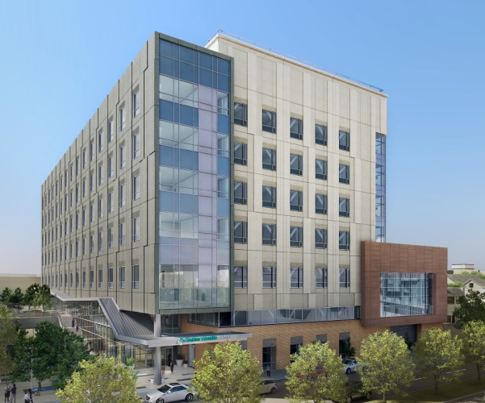
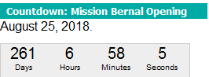
A look at Mission Bernal
Less than a year until we open!
Timeclock now on mySutter Intranet
Notes:
• Mission Bernal – scheduled to open August 2018- less than a year out
• The first of our new hospitals – so today, we want to give you a more detailed look.
• Acknowledge that many in audience may work elsewhere, but we are part of a whole – and a lot of what we’ll be doing at MB we will do at VN
(ST Lukes) – update the timeclock on day of presentation

Slide 11
New Hospital Features
All private patient rooms
Smart Hospital Technologies
Conference Rooms on the patient care floors to be used for our clinical staff (AV equipment and communication boards)
Interdisciplinary workrooms for staff and physicians
Support Functional Rooms
Artwork (showcasing local artists and our SF neighborhoods)
Notes:
Smart Hospital Technologies
Asset locating
Hand hygiene
Staff duress
Temperature monitoring
Infant security
Wandering adult
Patient entertainment – integrated with EPIC, CBORD
Wayfinding – static and dynamic
Conference room
Pneumatic Tube system with “secure send” transaction
Vocera
Storz
Support Functional Rooms
Clean holding
Soiled holding
Equipment storage
Nourishment
Med prep
Staff lounge

Slide 12
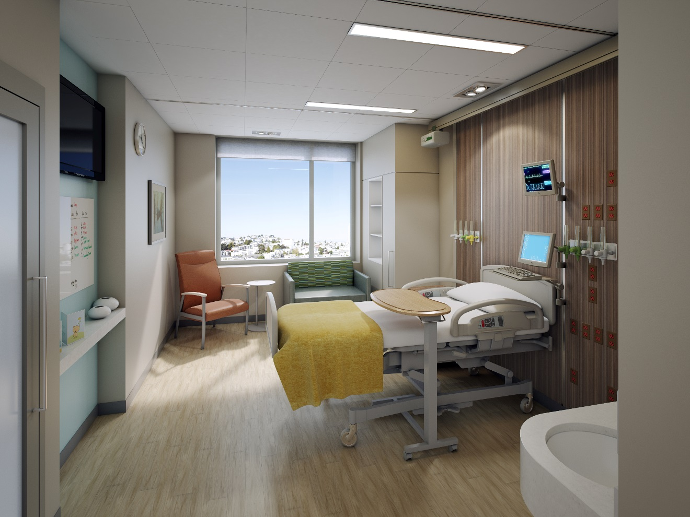
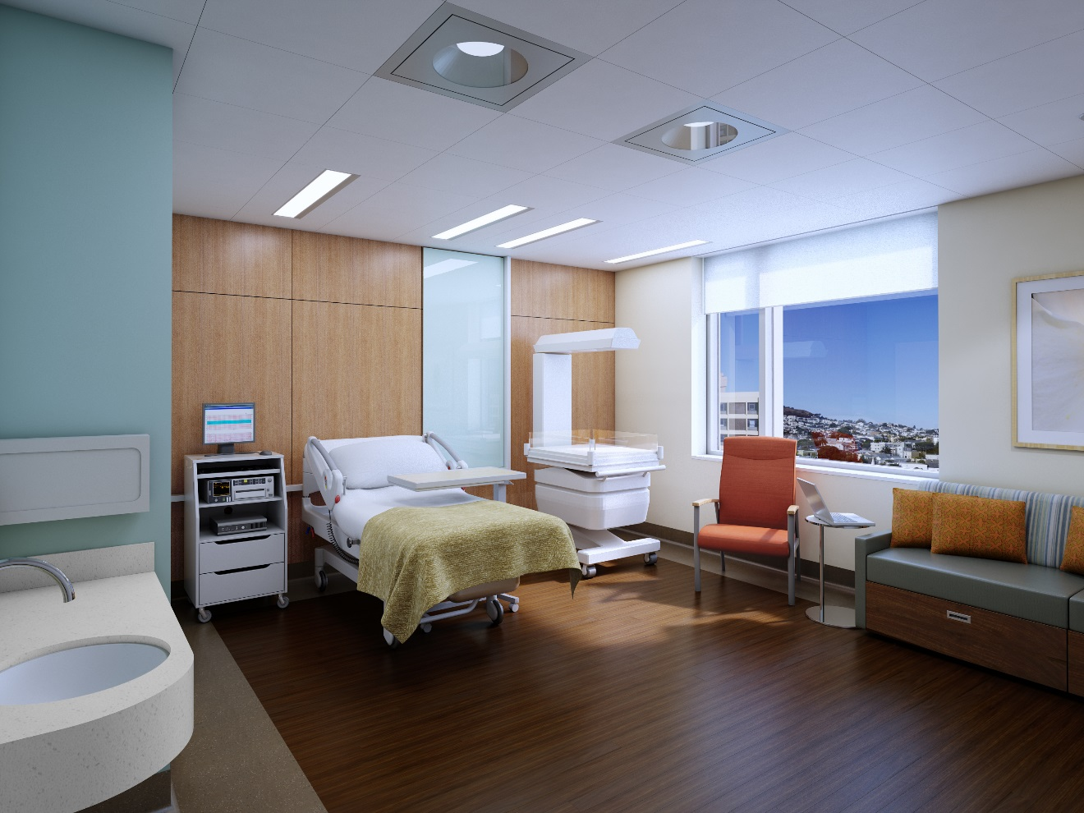
Typical Patient Rooms

Slide 13
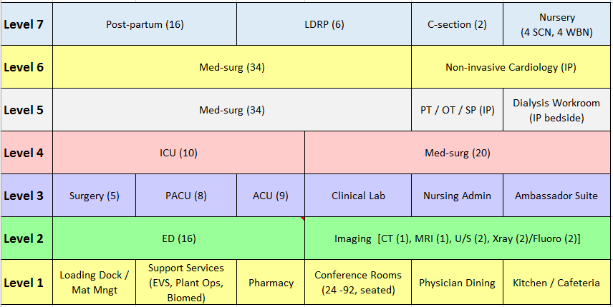
Mission Bernal Campus Hospital by floor

Slide 14
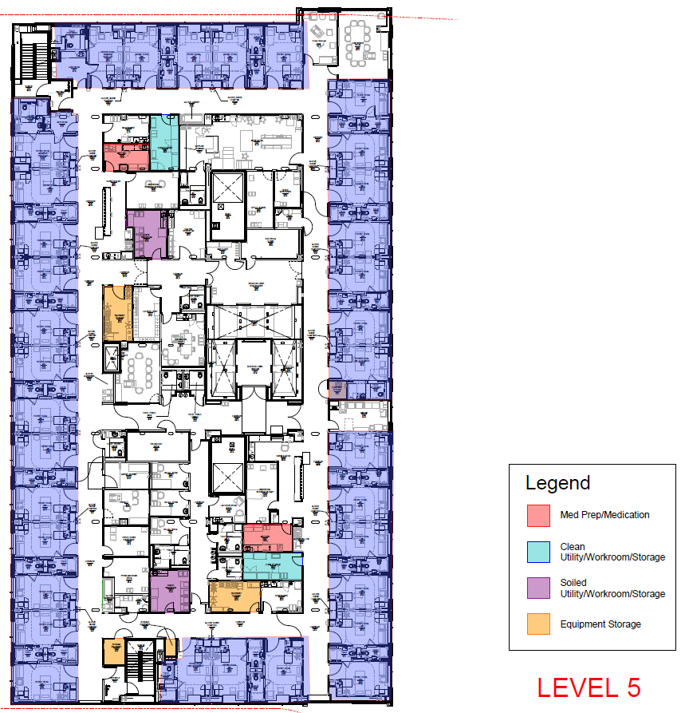
L5 – MedSurg/Acute Care for Elderly (34)
Conference
PT Gym
Nursing Station
InterdisciplinaryWorkroom
On Call Room (3)
Dialysis Workroom
Nursing Station
Activity Room
InterdisciplinaryWorkroom
Notes:
overview of a typical floor layout – to show how well it’s been planned … and point out hi-lights

Slide 15
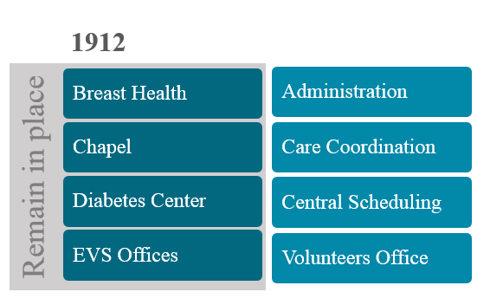
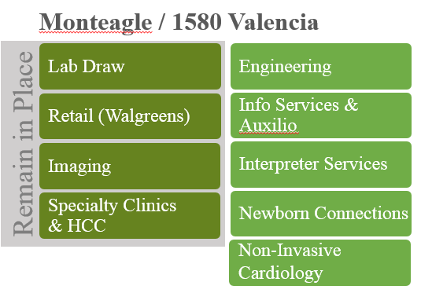
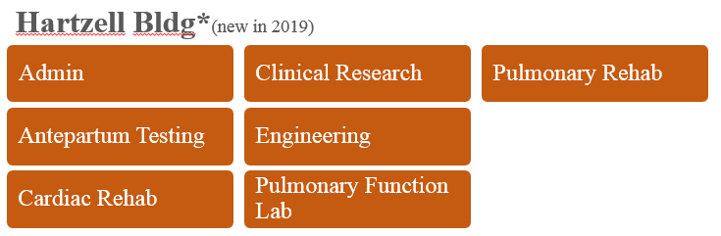
2018 Mission Bernal Campus Programs

Slide 16
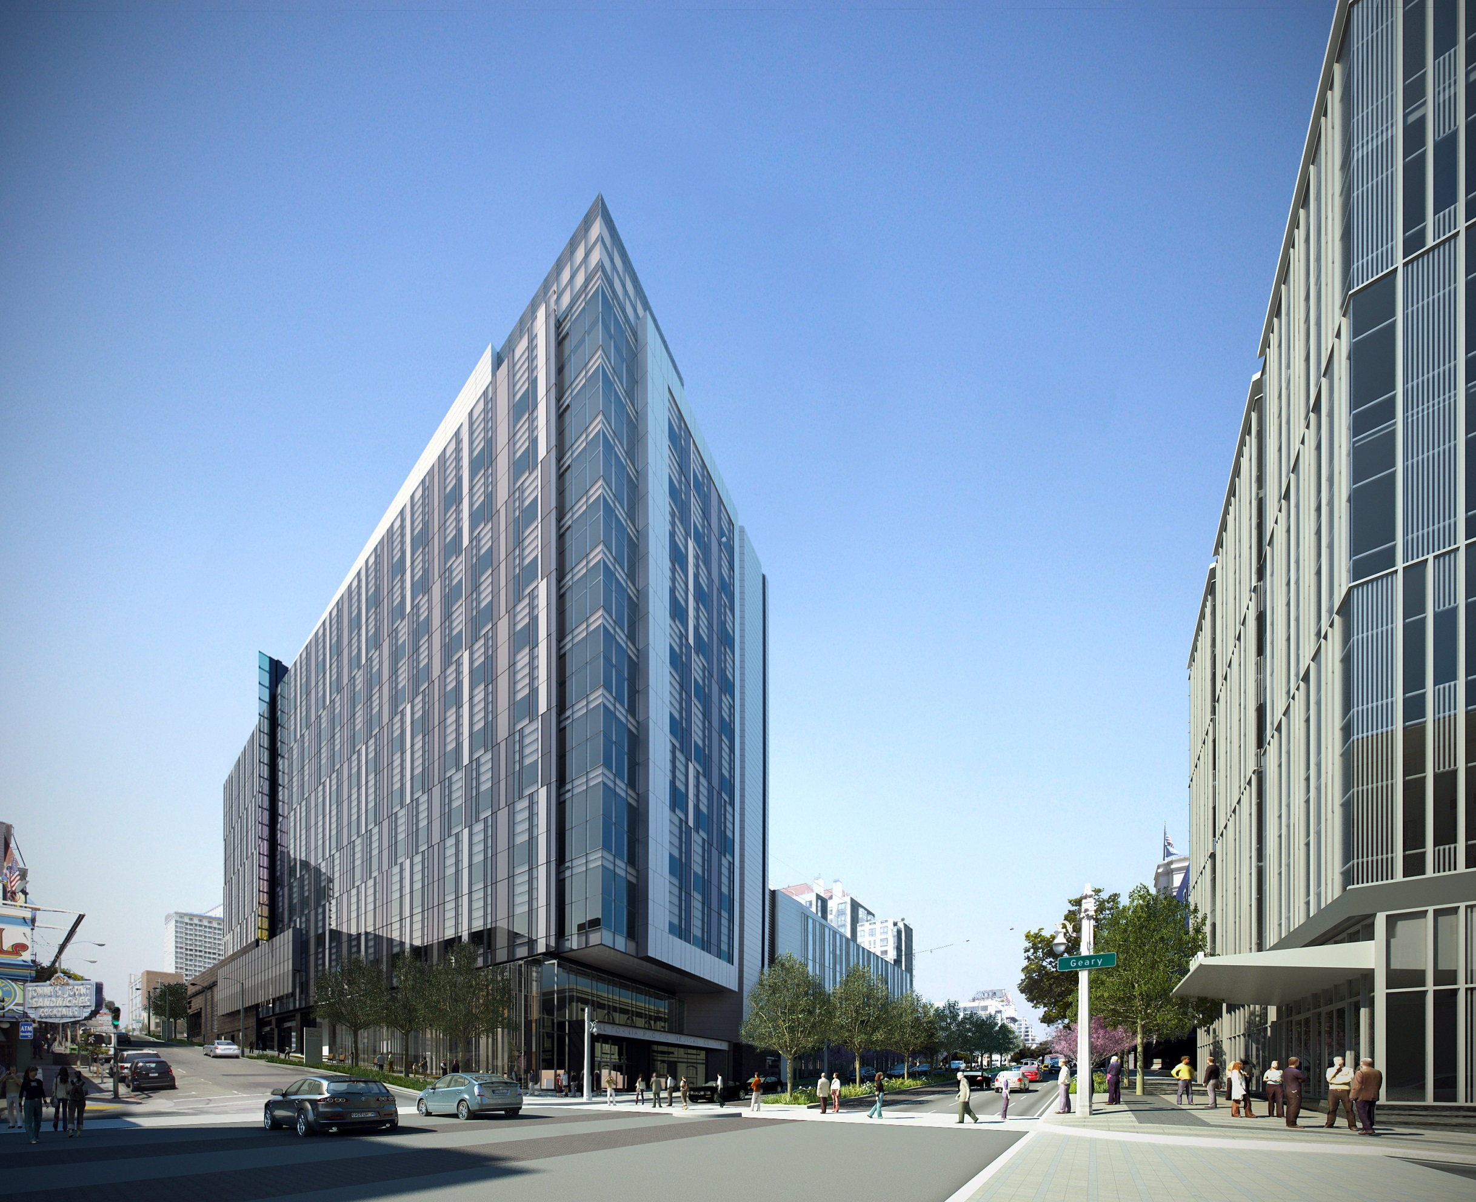
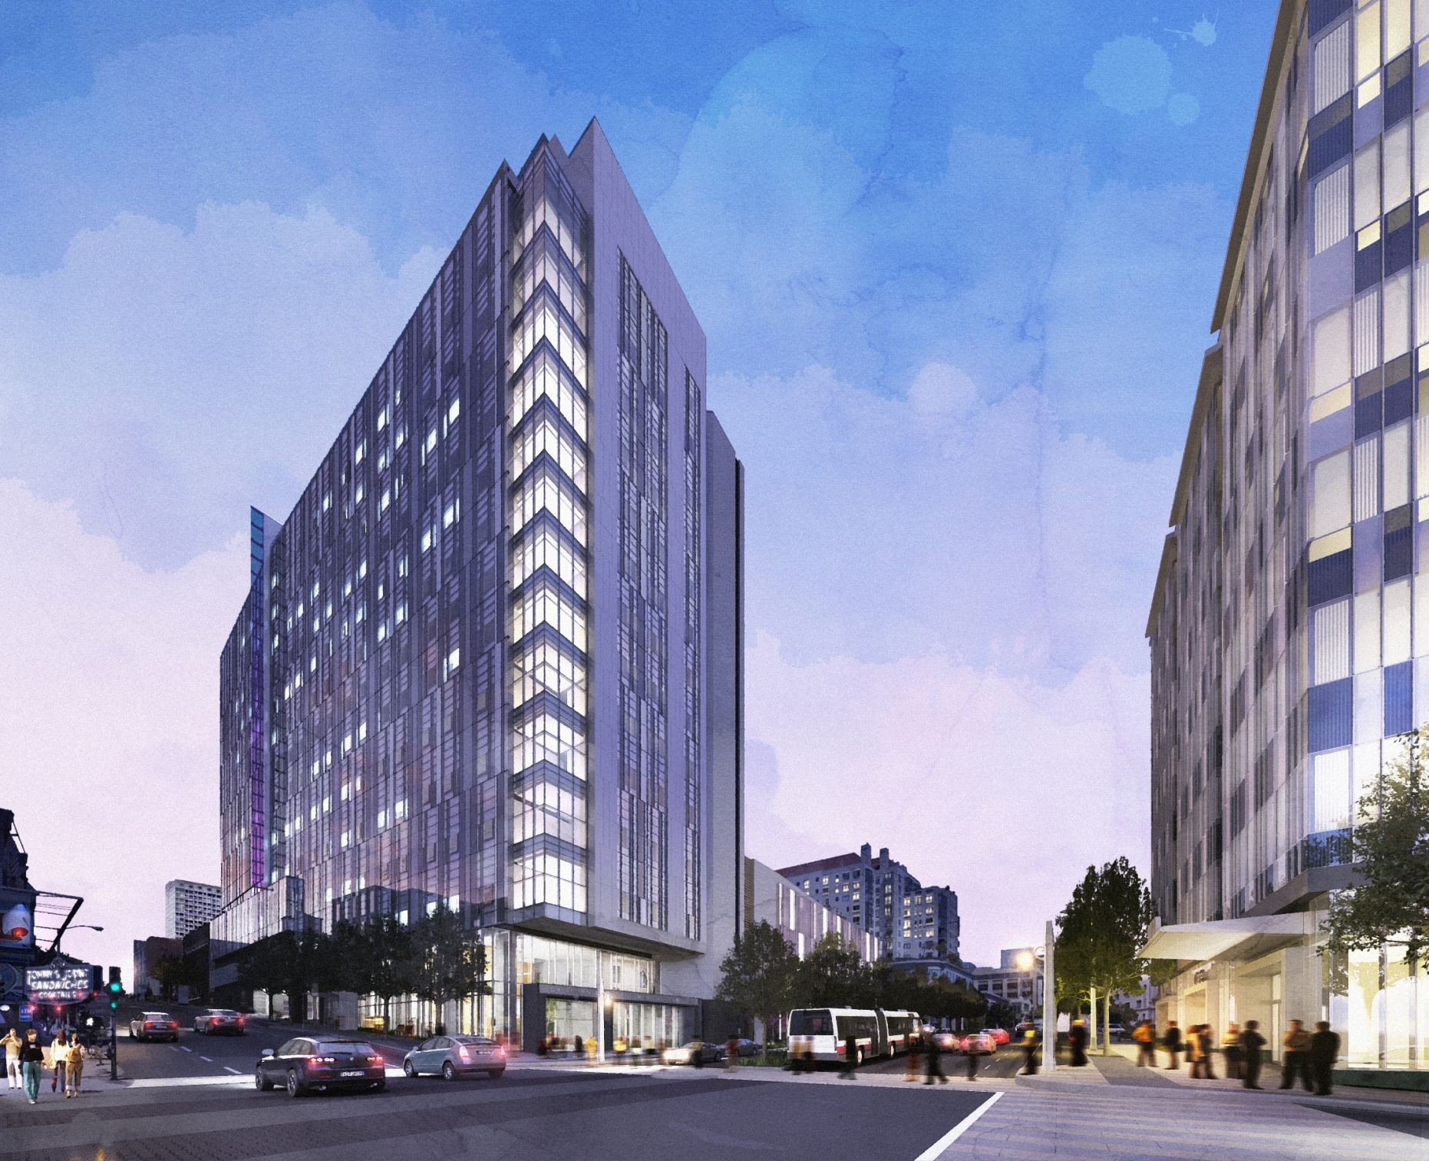
Van Ness Hospital

Slide 17
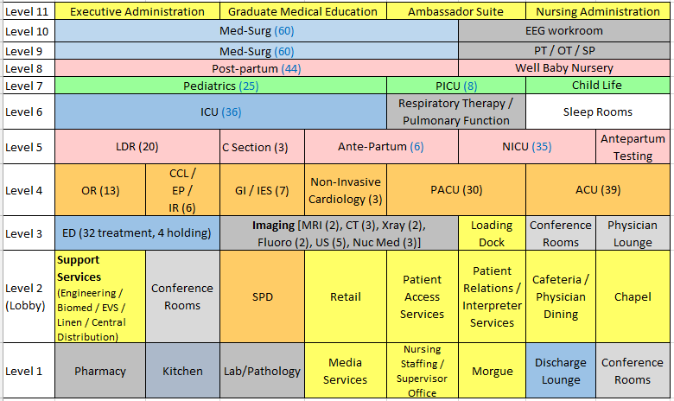
Van Ness Campus Hospital by floor

Slide 18
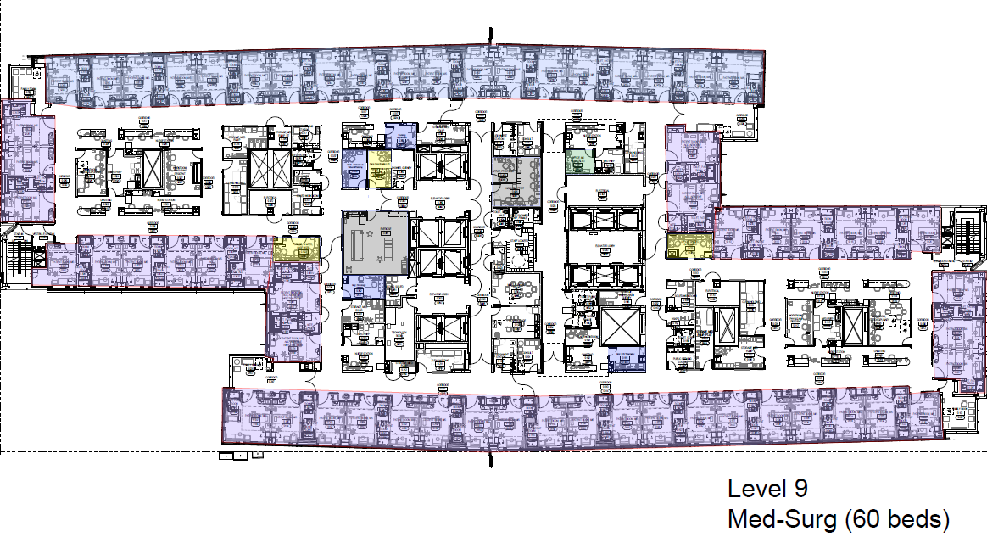
VNC Level 9
Notes:
overview of a typical floor layout – to show how well it’s been planned … and point out hi-lights

Slide 19
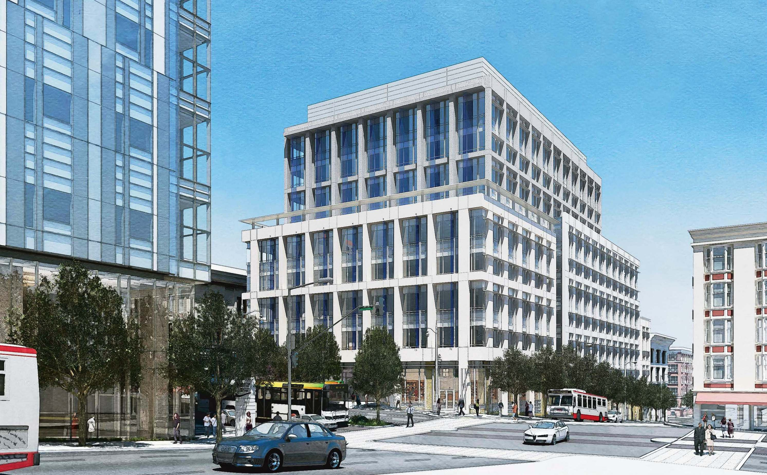

Van Ness MOB

Slide 20
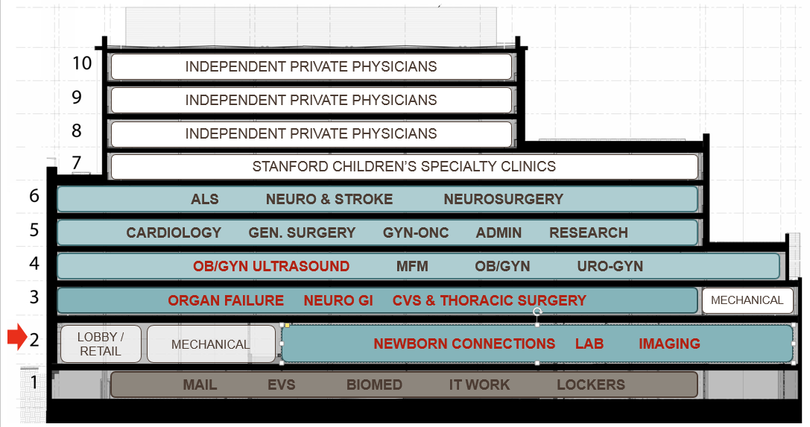
Van Ness MOB by floor

Slide 21
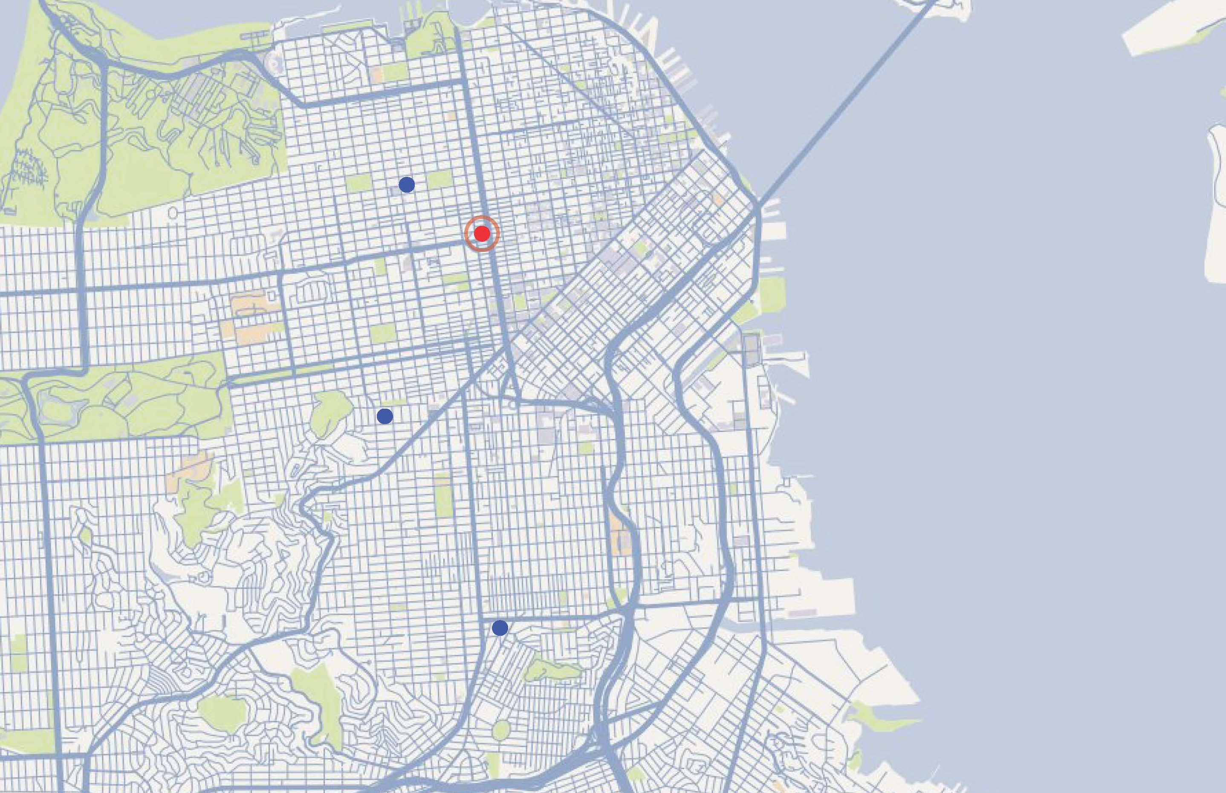
CPMC 2020 – City-wide Healthcare Delivery
Pacific Campus
Van Ness Campus
Davies Campus
Mission Bernal Campus
Notes:
Transition slide …
… We have updated you about our 2 beautiful new hospitals. Now, Jim and I will give you an overview of the future remaining campuses for CPMC 2020 and Transition Updates.

Slide 22
2019 California Campus Program Relocations
PAC Campus (renovated space Stanford and Buchanan)
Breast Health Center
Infection Control
Risk Management
Pharmacy (Limited / IV Compounding)
Diabetes
Medical Staff Services
Women’s Health Resource Center
Pelvic Medicine
2100 Webster
DAV Campus
Breast Care Clinic (SPMF)
Pathology
GME / FHC (SPMF)
VNC MOB
Other
OB/GYN Ultrasound
Cancer Info Service
Stanford Childrens
HIM
Notes:
Either use 22 & 23 OR 24-26

Slide 23
2019 Pacific Campus Program Relocations
PAC Campus (renovated space Stanford)
Accreditation & Licensing
CPMC Research Institute
IS (PAC)
Auxilio
Informatics
Melanoma & Head/Neck
PAC Campus (remain in place)
Ambulatory Surgery
Care Coordination (Overflow)
Histo Lab
Cancer Center
Centralized Mail
Organ Failure Biorepository
Cardiac NIL
HELP
Quality & Safety
Pathology
VNC
DAV
MBC
Imaging
PT/OT
Cardiac Rehab
GI & IES
Behavioral Health
Pulmonary Rehab
Notes:
May Need to wait on sharing this with staff (*Hamila / Chin)

Slide 24
2020 Future State
PAC Campus (renovated space Stanford)
PAC Campus (remain in place)
Accreditation & Licensing
CPMC Research Institute
Ambulatory Surgery
Care Coordination (Overflow)
2016 Locations:
Auxilio
Diabetes
Cancer Center
Centralized Mail
PAC
CAL
Davies
633 Folsom
Library
Breast Health Center
Infection Control
Cardiac NIL
HELP
Informatics
Melanoma & Head/Neck
Histo Lab
Program in Medical and Human Values
IS (PAC)
Risk Management
Library Operations (Gerbode)
Quality & Safety
Medical Staff Services
WHRC
Organ Failure Biorepository
Melanoma (SPMF)
Nuclear Medicine
Pelvic Medicine
Head & Neck (SPMF)
Pharmacy Limited
Nuclear Medicine

Slide 25
2020 Future State Continued
Davies Campus
2100 Webster
Psychiatry IP & OP
PT / OT / SP
Breast Care Clinic (SPMF)
GME / FHC (SPMF)
2016 Locations:
PAC
CAL
Davies
633 Folsom
Library
Pathology
Outpatient Lab
Imaging Services
VNC
MBC
Infection Control
Gastrointestinal & IES
Ante-Partum Testing
Cardiac Rehab
Outpatient Pulmonary Function
Imaging
Pulmonary Rehab
VNC MOB
Imaging
OB Gyn Ultrasound

Slide 26
2020 Future State Continued
1625 Van Ness Ave.
1145 Market St
2016 Locations:
Admin / Care Coordination
Spiritual Care / Chaplains
Information Services
PAC
CAL
Davies
633 Folsom
Library
Quality Development Promotion Office
3838 California
Imaging Services
Outpatient Lab
1375 Sutter
Imaging Services
Outpatient Lab
eICU
Library Operations
2100 Webster
Imaging Services
Outpatient Lab

Slide 27
Transition Process is complicated
1,575
milestones
238
action items
(and counting)
332
900
existing technical applications to install
budget line items
90
new applications to install
Notes:
These hospital moves are complicated and involves a long road of detailed planning.
Imagine …
moving hundreds of pieces of equipment
getting the supplies stocked
orienting everyone to the new buildings
moving staff and patients
. . . all without interruption in patient care
Our primary responsibility is to make sure the moves are as smooth as possible and that we are ready to go.
We have implemented a very thoughtful and systematic approach for our hospital transition:
Our transition process is facilitated by Transition Consultants, who specialize in helping hospitals to transition/move into their new hospital.
Our overall process is overseen by our Transition Steering Committee, comprised of Executive Leadership, Senior Leadership and Key Department Leaders.
12 different focus groups meet monthly and report up to our Transition Steering Committee.
Planning meetings completed already, just for Mission Bernal Campus:
40 Occupancy Planning Meetings – to orient departments to the new hospital building and begin planning department workflow and processes
14 Support Planning Meetings for Mission Bernal Campus, where we meet with Support Departments and begin planning how they will support the entire hospital
28 Move Logistics Meetings – to prepare departments for the actual move process
There are other meetings and processes that will continue in our transition planning:
Clinical and Move Day meetings (~52)
Staff and Stock – starts in June 2018, where we begin to set up our new departments (while maintaining full operations at St Luke’s)
Licensing
Training for staff and physicians … everyone who is moving or working in one of the new hospitals … on entrances/paths of travel, use of ID badges, safety and other employee services.
There will also be general clinical training on operational processes and all of our new technology systems
And there will be department-specific training

Slide 28


Slide 29
Transition Planning Update
Mission Bernal Campus
Completed 40 Occupancy Planning meetings
Completed 14 Support Planning meetings
Completed 28 Move Logistics meetings
Continuing with Clinical and Move Day meetings (52)
Van Ness Campus
Occupancy Planning meetings complete
Support Planning meetings complete
Move Logistics meetings will start in January

Slide 30

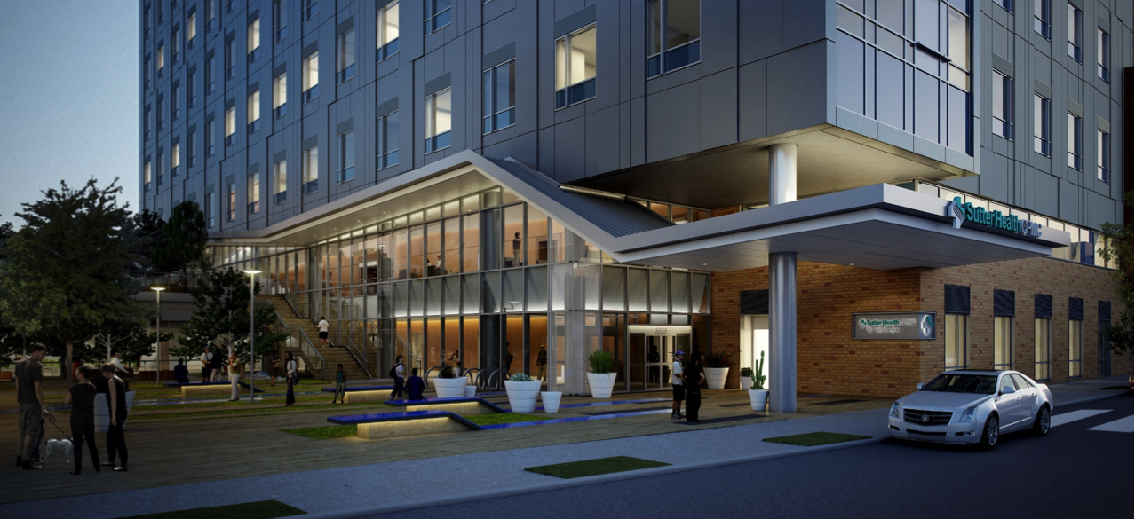
Mission Bernal OPENING Event's Timeline
“Rocking Our Health”
(Community Block Party, Staff Open House and Public Tours)
Aug 5, 2018
Ribbon Cutting/ Dedication
August 24, 2018
Opening Day
August 25, 2018
Goodbye to St. Luke’s
August 17, 2018

Slide 31
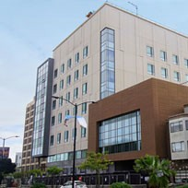
Rocking Our Health August 5, 2018
Community Block Party, Staff Open House and Public Tours
Good Health Rocks!
Welcome Neighbors and Community to Experience New Hospitals
Create Block Party Atmosphere
Conduct Mini-Tours of Hospital
(Designated Spaces Only)
Family Friendly Event
Notes:
An urban, slightly edgy, vibrant street style block party to celebrate the new hospital
Audience
San Francisco & Bay Area Neighbors and Communities
CPMC Staff, Leadership and Their Families
CPMC Donors
Construction Teams and Their Families
Patients and Families
Government Representatives and Business Leaders

Slide 32

Good-bye to St Luke’s August 17, 2018
Celebrate and acknowledge St. Luke’s for St Luke’s Staff and Leadership, as well as our patients and families

Slide 33

Official Ribbon Cutting Ceremony & Building Dedication August 24, 2018
Official Ribbon Cutting Ceremony & Building Dedication
Audience
CPMC staff and their families
CPMC Donors
San Francisco & Bay Area Communities
Government Representatives

Slide 34
Future Management Sessions
Management session – April 2018
Explain Staff and Stock
CDPH preparation
Move Day
Change Management
Management Session – October 2018 (i.e. before VNC Staff & Stock)
Lessons learned
Staff & Stock prep for VNC
CDPH Preparation
Change Management

Slide 35
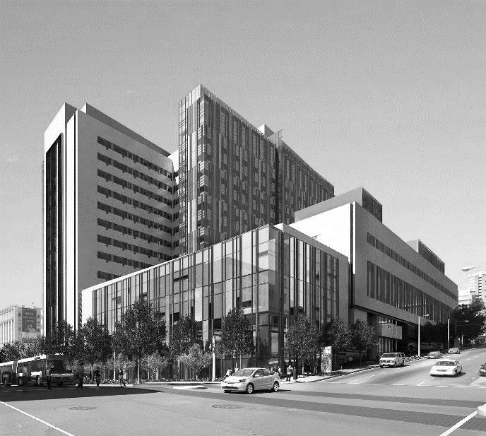

Questions?
Notes:
Kill? (EG)

